Slide 1
RUNGTA COLLEGE OF DENTAL SCIENCES & RESEARCH
TITLE OF THE TOPIC – DENTIN HYPERSENSITIVITY
DEPARTMENT OF CONSERVATIVE DENTISTRY AND ENDODONTICS

Slide 2
Specific learning Objectives
At the end of this presentation the learner is expected to know ;
Core areas* | Domain ** | Category #
Theories | Cognitive | Must know
Etiology | Cognitive | Must know
Treatment strategies | Psychomotor | Nice to know
*Subtopic of importance
** Cognitive, Psychomotor or Affective
# Must know , Nice to know & Desire to know
( Table to be prepared as per the above format )

Slide 3
Content
• Definition
• Neurophysiology of Teeth
• Mechanism of Dentin Sensitivity
• Incidence and Distribution of Dentin Hypersensitivity
• Etiology and Predisposing Factors
• Differential Diagnosis
• Diagnosis
• Treatment Strategies

Slide 4
Natural process contributing to desensitization
Formation of reparative dentin by the pulp
Obturation of tubules by the formation of mineral deposits (Dental sclerosis)
Calculus formation on the surface of the dentin.
Two principal treatment options
Plug the dentinal tubules preventing the fluid flow
Desensitize the nerve, i,.e it is less responsive to stimulation.
All the current modalities address these two options.

Slide 5
Treatment of dentin hypersensitivity can be divided into
Home care with dentifrices
Inoffice treatment procedure
Patient education.

Slide 6
Home care with dentifrices:
Strontium chloride dentifrices 
Potassium nitrate dentifrices 
Fluoride dentifrices.

Slide 7
In office treatment procedure:
Varnishes
 Corticosteroids
Treatments that partially obturate dentinal tubules.
i. Burnishing of dentin
ii. Silver nitrate
iii. Zinc chloride—potassium ferrocyanide
iv. Formalin
v. Calcium compounds.
a. Calcium hydroxide
b. Dibasic calcium phosphate.
vi. Fluoride compounds
a. Sodium fluoride
b. Sodium silicofluoride
c. Stannous fluoride

Slide 8
vii. Iontophoresis
viii. Strontium chloride
ix. Potassium oxalate.
 Tubule sealant
i. Restorative resins
ii. Dentin bonding agents.
Miscellaneous
i. Laser.
Patient education:
i. Dietary counseling
ii.Tooth brushing technique
iii.Plaque control.

Slide 9
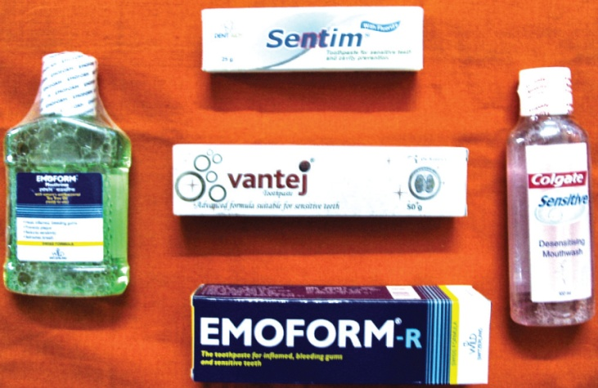
Home Care with Dentifrices
Dentifrice has been defined as a substance used with a toothbrush to aid in cleaning the accessible surfaces of the teeth.
Dentifrice components include abrasive, surfactant, humectant, thickener, flavor, sweetener, coloring agent and water.
After professional diagnosis, dentinal hypersensitivity can be treated simply and inexpensively by home use of desensitizing dentifrices.
The habit of tooth brushing with a dentifrice for cosmetic reasons is well established in the population, thus compliance with this regimen can be easily made.

Slide 10
Strontium Chloride Dentifrices
Ten percent strontium chloride desensitizing dentifrices have been found to be effective in relieving the pain of tooth hypersensitivity.
Potassium Nitrate Dentifrices
Five percent potassium nitrate dentifrices have been found to alleviate pain related to tooth hypersensitivity.
Fluoride Dentifrices
Sodium monofluorophosphates dentifrices are the effective mode of treating tooth hypersensitivity.

Slide 11
Criteria for selecting desensitizing agent
Provides immediate and lasting relief from pain
Easy to apply
Well tolerated by patients
Not injurious to the pulp
Does not stain the tooth
Relatively inexpensive.
Rationale of Therapy
According to hydrodynamic theory of hypersensitivity, a rapid movement of fluid in the dentinal tubules is capable of activating intradental sensory nerves. Therefore, treatment of hypersensitive teeth should be directed towards
reducing the anatomical diameter of the tubules,
obliteration of the tubules or
to surgically cover the exposed dentinal tubules so as to limit fluid movement.

Slide 12
Treatment Options to Reduce the Diameter of Dentinal Tubules can be
• Formation of a smear layer by burnishing the exposed root surface (smear layer consists of small amorphous particles of dentin, minerals and organic matrix— denatured collagen).
• Application of agents that form insoluble precipitates within the tubules.
• Impregnation of tubules with plastic resins.
• Application of dental bonding agents to seal off the tubules.
• Covering the exposed dentinal tubules by surgical means.
It must be recognized that single procedure may not be consistently effective in the treatment of hypersensitivity; therefore, the dentist must be familiar with alternative methods of treatment.
Prior to treating sensitive root surfaces, hard/soft deposits should be removed from the teeth.

Slide 13
Root planning on sensitive dentin may cause considerable discomfort, in this case, teeth should be anesthetized prior to treatment and teeth should be isolated and dried with warm air.
Varnishes
Open tubules can be covered with a thin film of varnish, providing a temporary relief; varnish such as copalite can be used for this purpose. For more sustained relief a fluoride containing varnish Duraflor can be applied.
Corticosteroids
Corticosteroids containing one percent prednisolone in combination with 25 percent parachorophenol, 25 percent methacresylacetate and 50 percent gum camphor was found to be effective in preventing postoperative thermal sensitivity.
The use of corticosteroids is based, on the assumption that hypersensitivity is linked to pulpal inflammation; hence, more information is needed regarding the relationship between these two conditions.

Slide 14
Partial Obliteration of Dentinal Tubules
Burnishing of dentin: Burnishing of dentin with a toothpick or orange wood stick results in the formation of a smear layer. This layer partially occludes the dentinal tubules which help in reducing the hypersensitivity.
Formation of insoluble precipitates to block tubules:
Certain soluble salts react with ions in tooth structure to form crystals on the surface of the dentin.
To be effective, crystallization should occur in 1-2 minutes and the crystals should be small enough to enter the tubules and must also be large enough to partially obturate the tubules.
• Calcium oxalate dihydrate crystals are formed when potassium oxalate is applied to dentin; these crystals are very effective in reducing permeability.

Slide 15
• Silver nitrate (AgNO3) has ability to precipitate protein constituents of odontoblast processes, thereby partially blocking the tubules.
• Zinc chloride—potassium ferrocyanide: When applied forms precipitate, which is highly crystalline and covers the dentin surface.
• Formalin 40 percent is topically applied by means of cotton pellets or orangewood sticks on teeth. It had been proposed by Grossman in 1935 as the desensitizing agent of choice in treating anterior tooth because, unlike AgNO3, it does not produce stain.
• Calcium compounds have been popular agent for many years for the treatment of hypersensitivity. The exact mechanism of action is unknown but evidence suggests that:

Slide 16
– It may block dentinal tubules
– May promote peritubular dentin formation
– On increasing the concentration of calcium ions around nerve fibers, may result in decreased nerve excitability. So, calcium hydroxide might be capable of suppressing nerve activity.
i. A paste of Ca(OH)2 and sterile distilled water applied on exposed root surface and allowed to remain for 3-5 minutes, can give immediate relief in 75 percent of cases.
ii. Dibasic calcium phosphate when burnished with round toothpick forms mineral deposits near the surface of the tubules and found to be effective in 93 percent of patients.

Slide 17
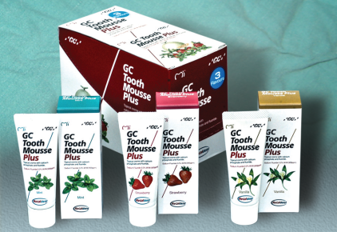
GC tooth mousse for tooth remineralization, thereby reducing hypersensitivity
Recaldent (CPP-ACP)
CPP-ACP (complex of casein phosphopeptides and amorphous calcium phosphate).
CPPs are group of peptides derived from casein. Casein is the part of protein which naturally occurs in milk, CPP is responsible for high availability of Ca2+ from milk.
In normal state calcium phosphate forms a crystalline structure at neutral pH and thus becomes insoluble.
But CPP keeps calcium and phosphorus in ionic form (amorphous state). In this state, calcium and phosphate ions can enter the tooth enamel and thus promote remineralization of tooth.
Recently, a sugar free, water based cream containing RECALDENT (CPP-ACP) has been made available under the name GC tooth mousse.

Slide 18
Fluoride compounds: Lukomsky (1941) was the first to propose sodium fluoride as desensitizing agent, because dentinal fluid is saturated with respect to calcium and phosphate ions. Application of NaF leads to precipitation of calcium fluoride crystals, thus, reducing the functional radius of the dentinal tubules.
– Acidulated sodium fluoride: Concentration of fluoride in dentin treated with acidulated sodium fluoride is found to be significantly higher than dentin treated with sodium fluoride.
– Sodium silicofluoride: Silicic acid forms a gel with the calcium of the tooth and produces an insulating barrier. Thus application of 0.6 percent sodium silicofluoride is much more potent than 2 percent solution of sodium fluoride as desensitizing agent.
– Stannous fluoride: Ten percent solution of stannous fluoride forms dense layer of tin and fluoride containing globular particles blocking the dentinal tubules. 0.4 percent stannous fluoride is also an effective agent, however, requires prolonged use (up to 4 weeks) to achieve satisfactory results.

Slide 19
Fluoride iontophoresis: Iontophoresis is a term applied to the use of an electrical potential to transfer ions into the body for therapeutic purposes. The objective of fluoride iontophoresis is to drive fluoride ions more deeply into the dentinal tubules that cannot be achieved with topical application of fluoride alone.
Strontium chloride: Studies have shown that topical application of concentrated strontium chloride on an abraded dentin surface produces a deposit of strontium that penetrates dentin to a depth of approximately 10 to 20 μm and extend into the dentinal tubules.
Oxalates: Oxalates are relatively inexpensive, easy to apply and well tolerated by patients. Potassium oxalate and ferric oxalate solution make available oxalate ions that can react with calcium ions in the dentin fluid to form insoluble calcium oxalate crystals that are deposited in the apertures of the dentinal tubules.

Slide 20
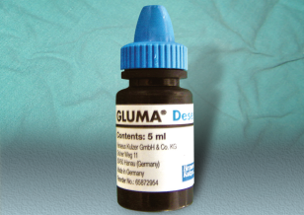
Dental Resins and Adhesives
The objective in employing resins and adhesives is to seal the dentinal tubules to prevent pain producing stimuli from reaching the pulp.
Several investigators have demonstrated immediate and enduring relief of pain for periods of up to 18 months following treatment.
Although not intended for treatment of generalized areas of root sensitivity, this can be an effective method of treatment when other forms of therapy have failed.
GLUMA is a dentin bonding system that includes glutaraldehyde primer and 35 percent HEMA (hydroxyethyl methacrylate). It provides an attachment to dentin that is immediate and strong. GLUMA has been found to be highly effective when other methods of treatment failed to provide relief.

Slide 21
Lasers
Treatment of Dentin Hypersensitivity by Lasers
Kimura Y et al (2000) reviewed treatment of dentin hypersensitivity by lasers. The lasers used for the treatment of dentin hypersensitivity are divided into two groups:
1. Low output power (low level) lasers: Helium-neon [He-Ne] and gallium/aluminum/arsenide (GaAIAs) [diode] lasers
2. Middle output power lasers: Nd:YAG and CO2 lasers.
Laser effects are considered to be due to the effects of sealing of dentinal tubules, nerve analgesia or placebo effect. The sealing effect is considered to be durable, whereas nerve analgesia or placebo effects are not.

Slide 22
Patient Education
Dietary Counseling
Dietary acids are capable of causing erosive loss of tooth structure, thereby removing cementum and resulting in opening of the dentinal tubules.
Consequently, dietary counseling should focus on the quantity and frequency of acid intake and intake occurring in relation to tooth brushing.
Any treatment may fail if these factors are not controlled.
A written diet history should be obtained on patients with dentinal hypersensitivity in order to advise those concerning eating habits.
Because of the presence of a smear layer on dentin, teeth are not usually sensitive immediately following scaling and root planning. However, removal of the smear layer may result from exposure to certain components of the diet.

Slide 23
Studies have shown that citrus fruit juices, apple juice and yoghurt are capable of dissolving the smear layer.
loss of dentin is greatly increased when brushing is performed immediately after exposure of the tooth surface to dietary acids, patients should be cautioned against brushing their teeth soon after ingestion of citrus food.
Toothbrushing Technique
Because incorrect toothbrushing appears to be an etiologic factor in dentin hypersensitivity, instruction about proper brushing techniques can prevent further loss of dentin and the hypersensitivity.

Slide 24
Plaque Control
Saliva contains calcium and phosphate ions and is therefore able to contribute to the formation of mineral deposits within exposed dentinal tubules.
The presence of plaque may interfere with this process, as plaque bacteria, by producing acid, are capable of dissolving any mineral precipitates that form, thus opening tubules.
Professional interest in the cause and treatment of dentinal hypersensitivity has been evident in the dental literature for approximately 150 years or more.
Dentinal hypersensitivity satisfies all the criteria to be classified as a true pain syndrome.

Slide 25
Myelinated A fibers mostly A-delta type seems to be responsible for the sensitivity of dentin.
Of the various theories proposed, the hydrodynamic theory is the most accepted explanation for the mechanism of dentin hypersensitivity. Management of the condition requires determination of etiologic factors and predisposing influences.
Desensitizing toothpastes containing potassium nitrate, strontium chloride and sodium monofluorophosphate have proven to be effective in the management of hypersensitivity.
Partial obturation of open tubules the most widely practiced in office treatment of dentinal hypersensitivity.

Slide 26
TAKE HOME MESSEGE/ FOR THE TOPIC COVERED (SUMMARY)
• A careful history together with a thorough clinical and radiographic examination is necessary before arriving at a definitive diagnosis of dentin hypersensitivity. However, the problem may be made difficult when two or more conditions coexist.
• Tooth hypersensitivity differs from dentinal or pulpal pain. In case of dentin hypersensitivity, patient’s ability to locate the source of pain is very good, whereas in case of pulpal pain, it is very poor.

Slide 27
Question & Answer Session
Short note on ACP- CPP
Theories of dentinal hypersensitivity.
Short note on dentrifices.

Slide 28
REFERENCES
ORBAN’S HISTOLOGY AND EMBRYOLOGY 12TH EDITION
ANTONIO NANCI- TEN CATE’S ORAL HISTOLOGY- DEVELOPMENT STRUCTURE AND FUNCTION- 6TH EDITION

Slide 29
THANK YOU

